Slide 1


GAME PRESENTATION
Depths of Dread

Slide 2

Key Features
Psychological Thriller
Elements
Sanity System
Supernatural Threats
Hallucinations and auditory distortions.
Paranoia triggers near water or isolated areas.
Visuals: Examples of screen distortions, eerie fog, or shadowy figures
Low sanity → visual distortions, phantom enemies, impaired aiming.
Restore sanity → safe zones, light sources, calming items.
Visuals: Sanity meter bar, color-coded changes, hallucination effect screenshots
Ghostly figures, drowned spirits, monstrous sea creatures.
Threats affect both players and the environment (fog, sounds).
Visuals: Sea monster rising from waves, ghostly silhouettes

Slide 3

Dynamic Island Environment
. Island layout changes subtly each match.
Buildings shift, paths appear/disappear, mysterious symbols glow.
Visuals: Map comparison showing shifts or glowing symbols
Light & Sound Mechanics
Flashlights, flares, and sound devices are double-edged: help detect threats but attract attention.
Visuals: Player with flashlight, eerie glowing eyes in the dark
Key Features
Multiplayer Mind Games
Plant false clues, use hallucinations to mislead opponents.Psychological tactics are as important as combat skill
Visuals: Confused player silhouettes, directional arrows.

Slide 4


#
#
#
Players are trapped on a remote, fog-shrouded island surrounded by a dark, stormy sea.
Survive both other players and supernatural horrors.
Hallucinations, whispers, and mysterious events blur the line between reality and nightmare.
CORE CONCEPT

Slide 5
CLASS
STRENGTHS
Investigator
Spot clues, calm sanity, detect supernatural signs
Combat skills, traps, tracking
Hunter
Sense supernatural threat manipulate hallucinations
Mystic

Slide 6


Why It’s Addictive
Fast-paced PvP + psychological horror tension.
Unpredictable combat due to sanity system.
Dynamic environment keeps matches fresh.
Strategic use of light, sound, and mind games.
CONTINUE
Back to Panel

Slide 7
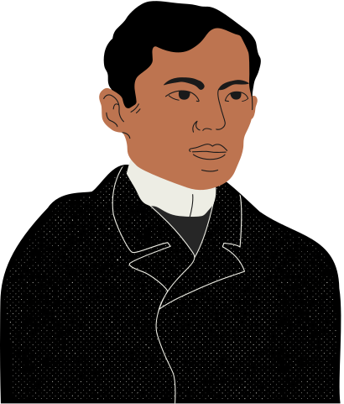
IMMERSIVE STYLE
Foggy, muted colors; dynamic shadows.
Visuals

Slide 8

AUDIO
3D spatial audio, dynamic soundtrack reacting to sanity.

Slide 9
Visuals
Concept art of island, fog, stormy sea, and ghostly figure
KILL YOU
Back to Panel
CONTINUE

Slide 10


THANK YOU!

